Slide 1

Vote More
Annie Zheng
Sally Hu
Yuzheng Zhang

Slide 2
Introduction
Vote is important
Encourage more voting

Slide 3
Recap
Building Type Distribution in Madison
Building Type Count Statistics
One more Polling Place

Slide 4
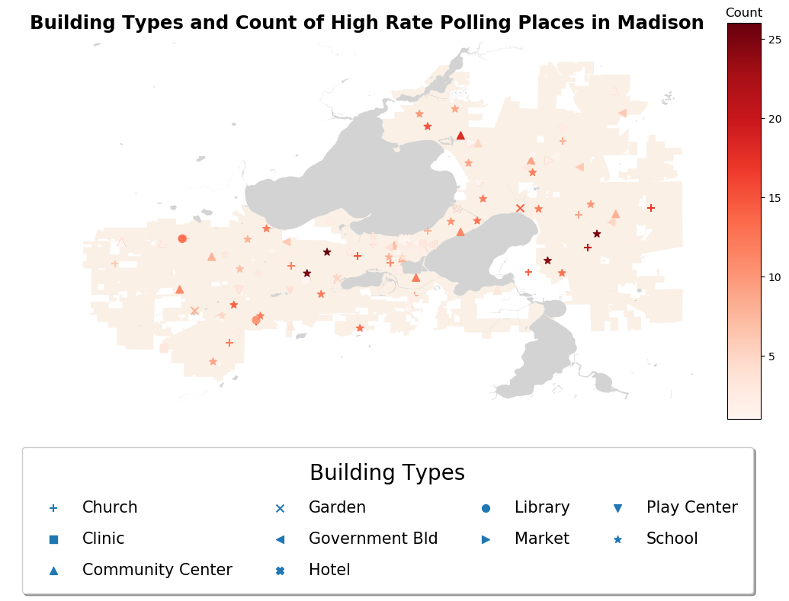

Slide 5
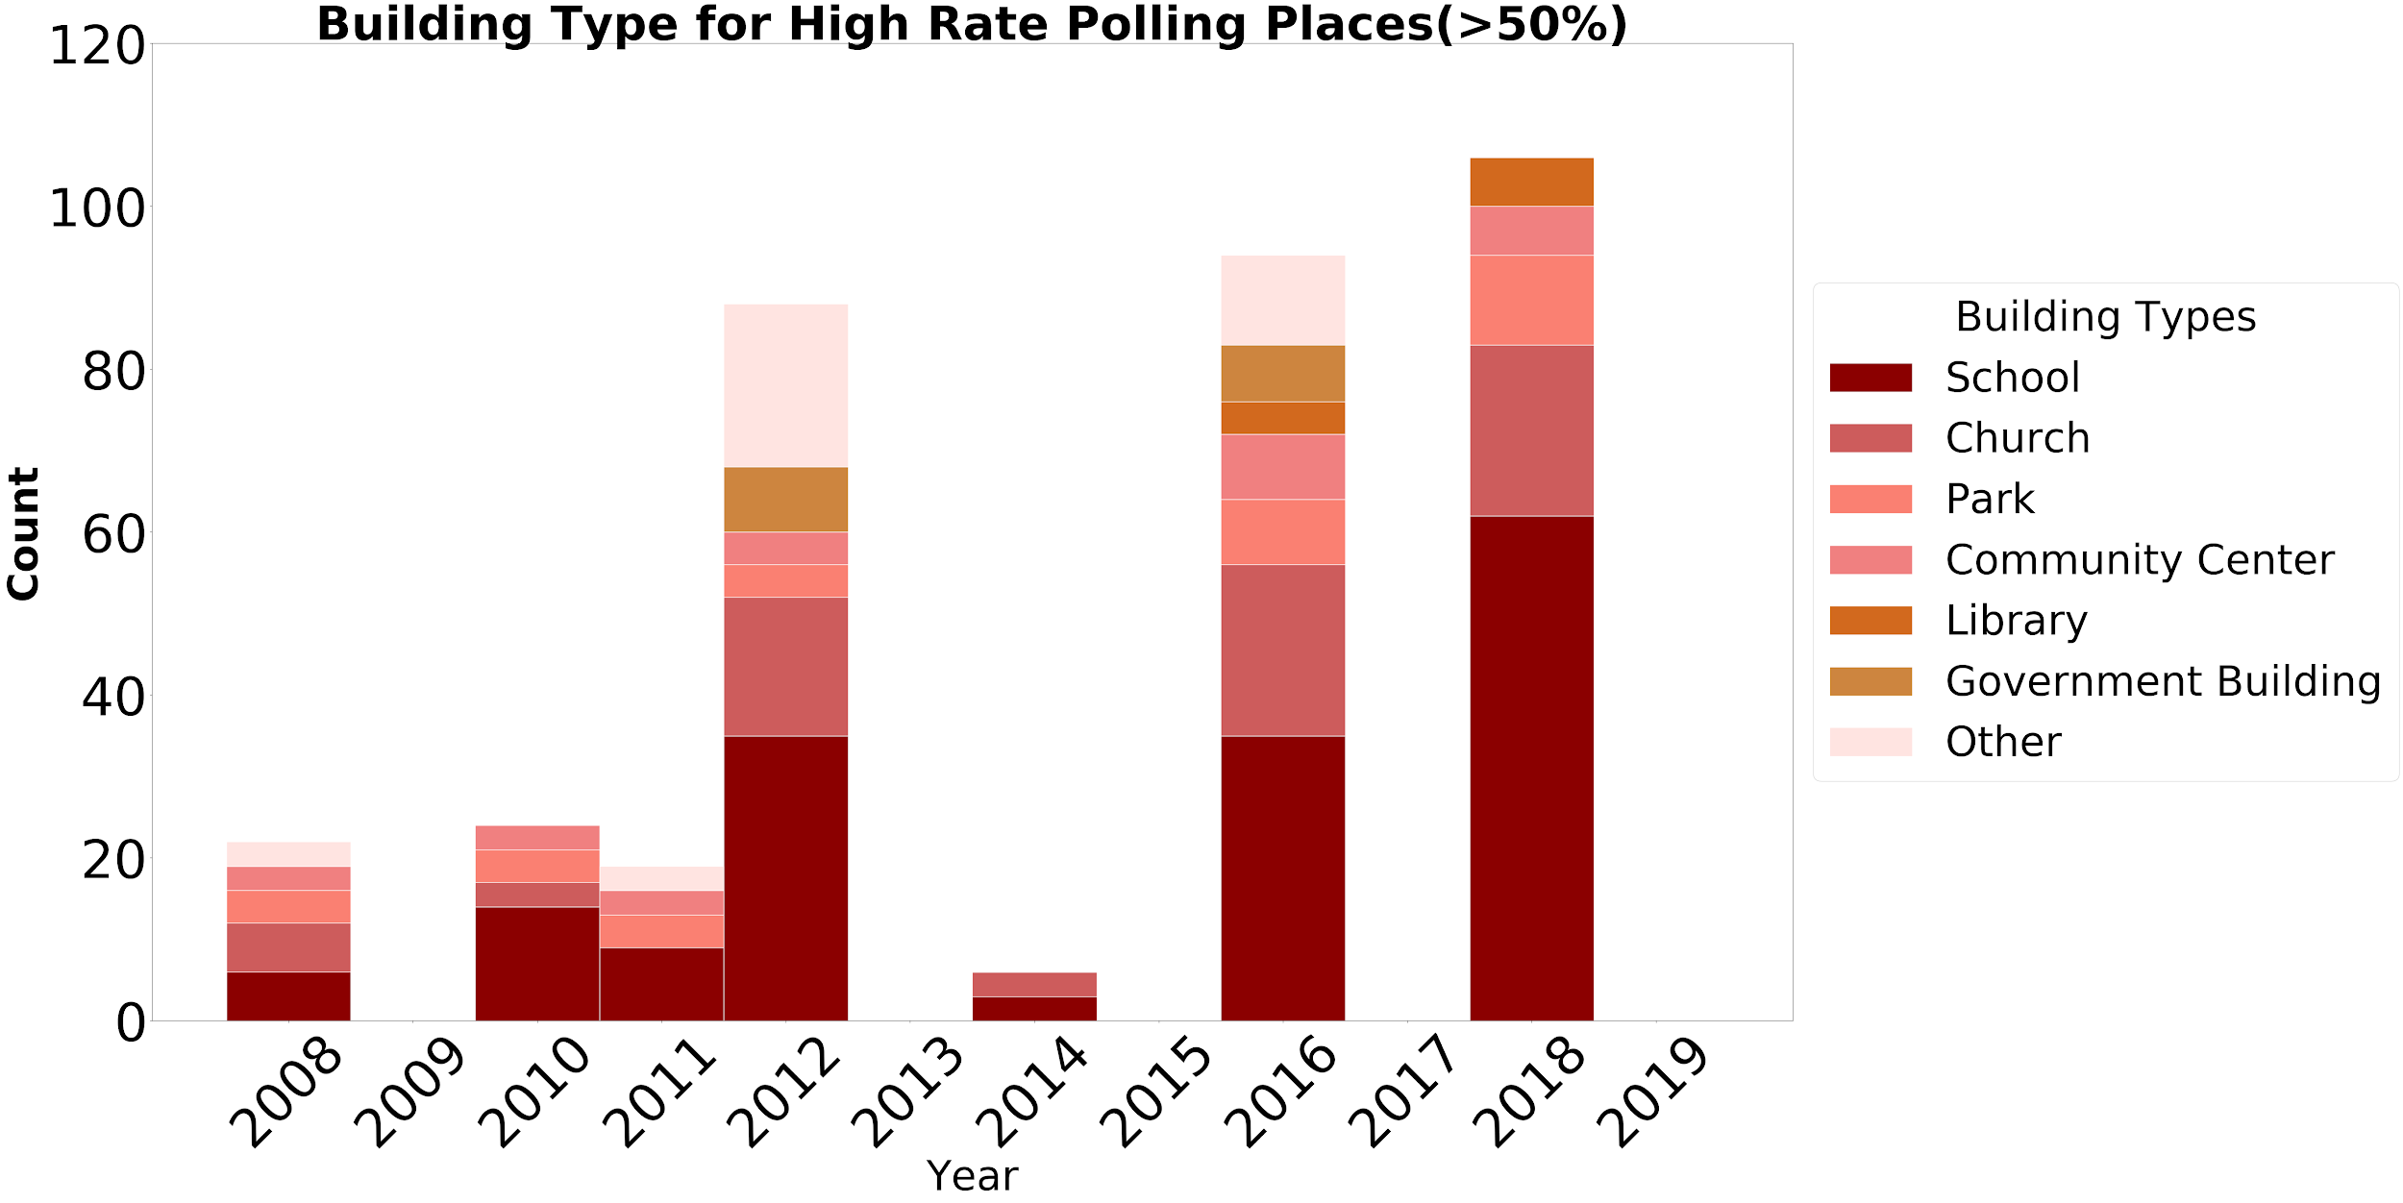

Slide 6
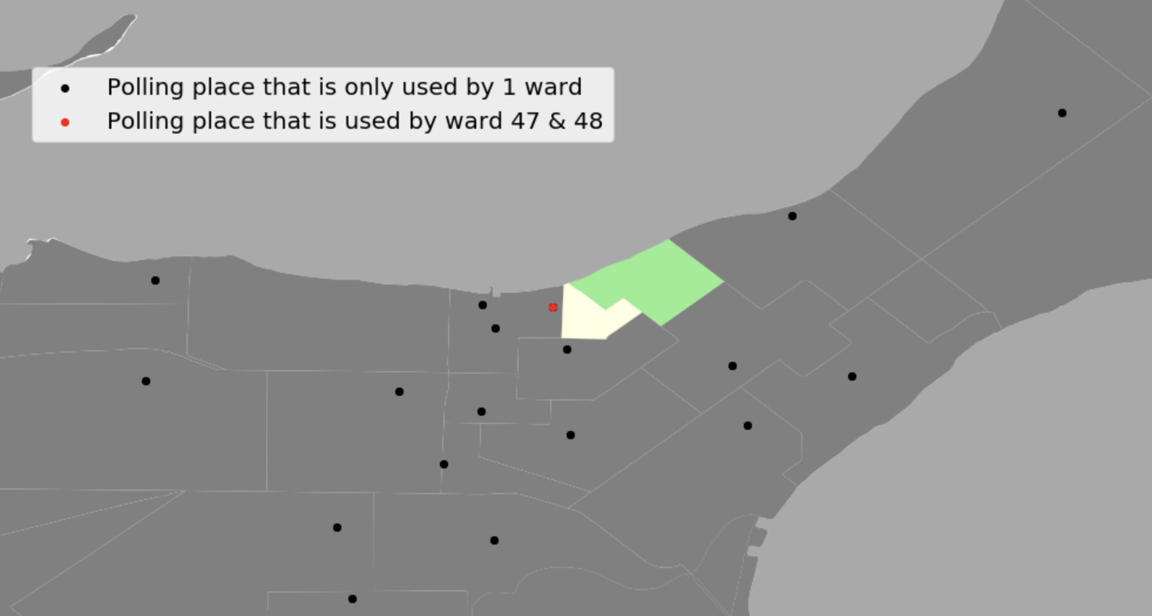
Ward 47 and ward 48 have relative low turnout rates, which are less than 70% in 3 successive presidential elections(2008,2012,2016).
Multiple wards (larger area) with only one polling place
Polling place is outside the wards area

Slide 7
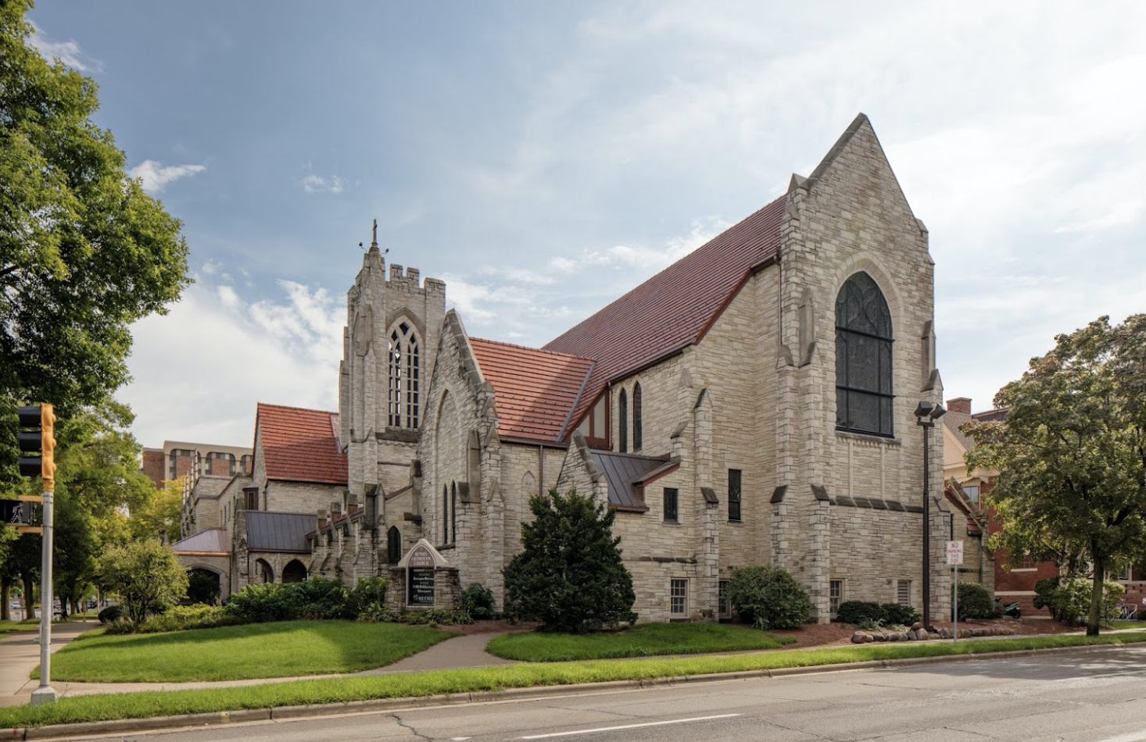
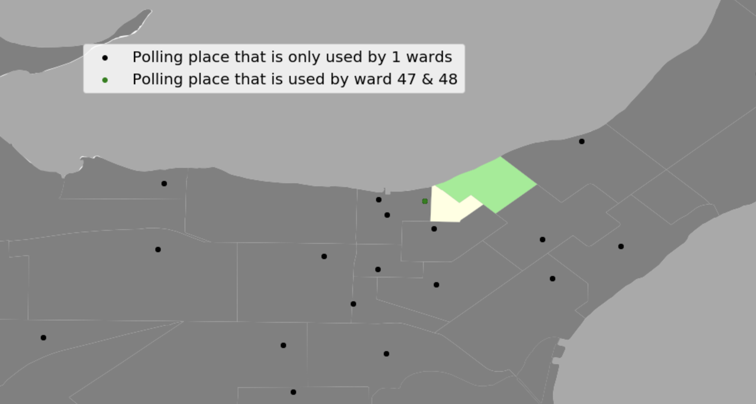
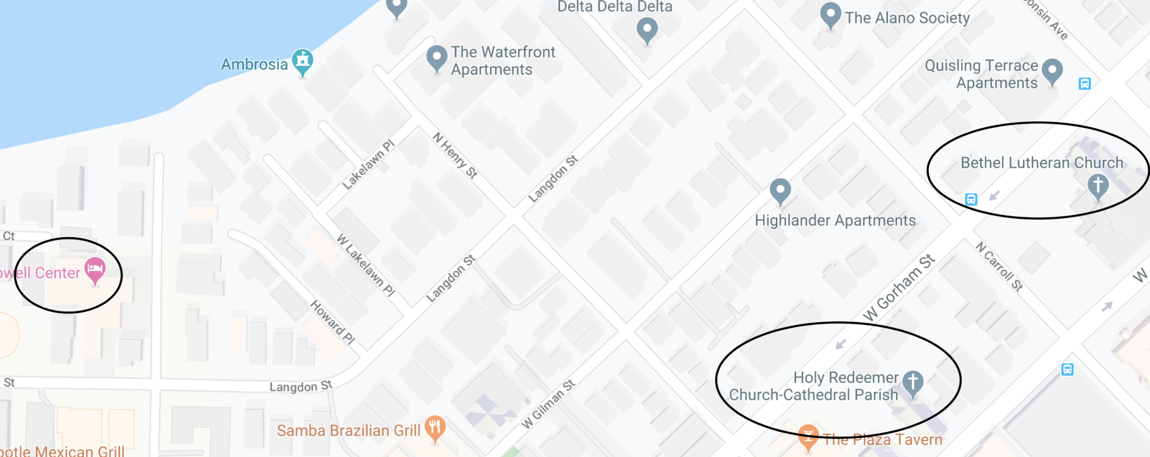
Although ward 47 is further than ward 48, the turnout rate is higher.
The reason is more old people in ward 48 and old people are willing to vote.

Slide 8
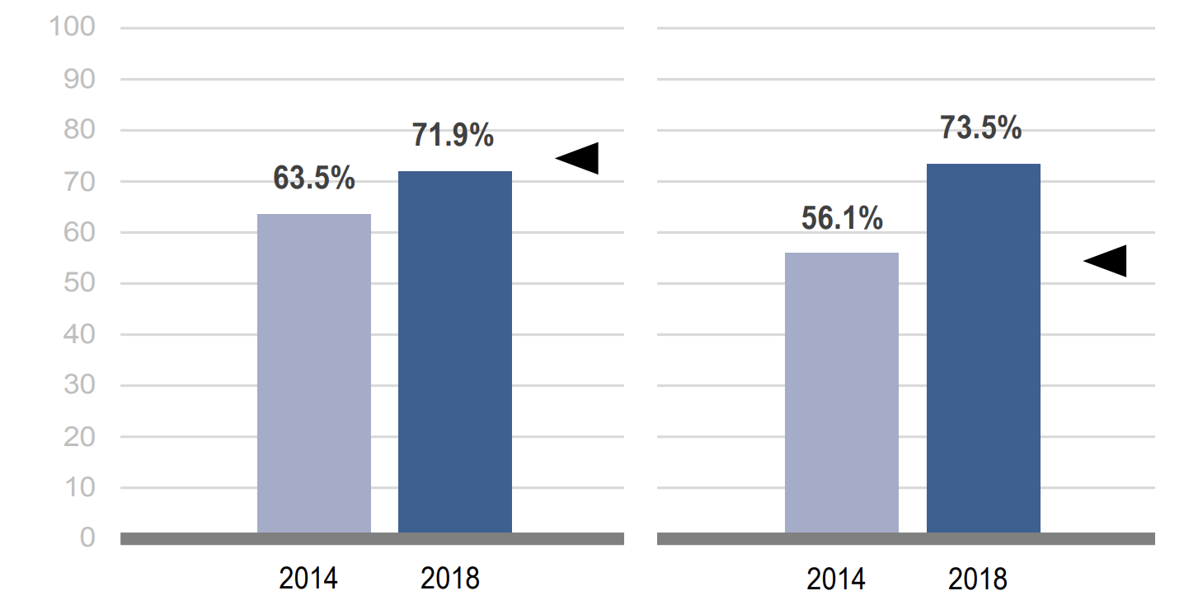
Advertisement and Education
UW-Madison Students Registration Rate
Turnout Rate of Registered Students
*The data above is from “Student Voting Rates for University of Wisconsin-Madison” by NSLVE

Slide 9
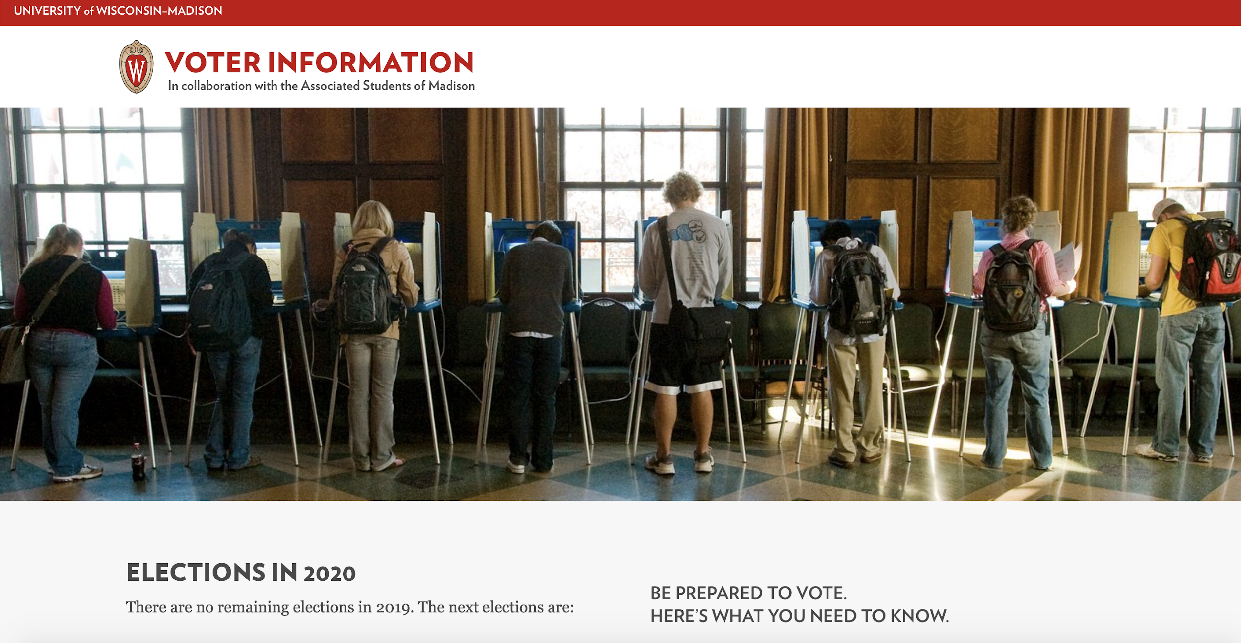
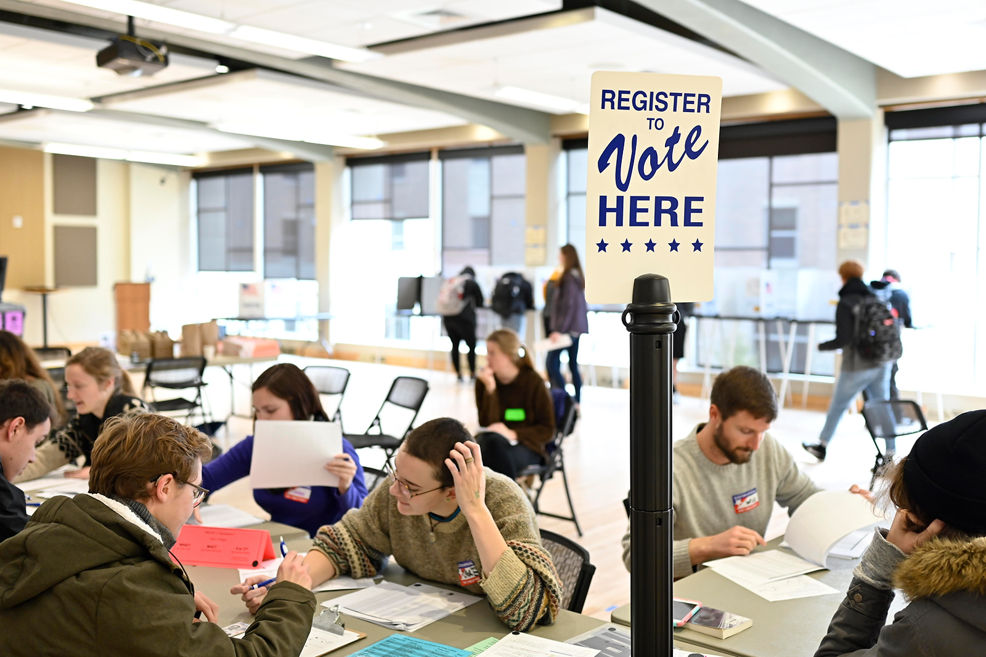
Advertisement and Education
The partnership between the Madison City Clerk’s Office, Associated Students of Madison, the Morgridge Center for Public Service and a number of other campus units ensured that thousands of UW–Madison students were educated and engaged during the 2018 elections. The efforts, which won a 2019 Community-University Partnership Award.
UW-Madison’s voting awareness efforts will continue in the presidential election year of 2020 under the leadership of the Badgers Vote Coalition, the successor group to the Big Ten Voting Challenge Committee.

Slide 10


Advice
Keep up the good work!

Slide 11
Some Factors that affect turnout rate
Decision Tree
Summary

Slide 12
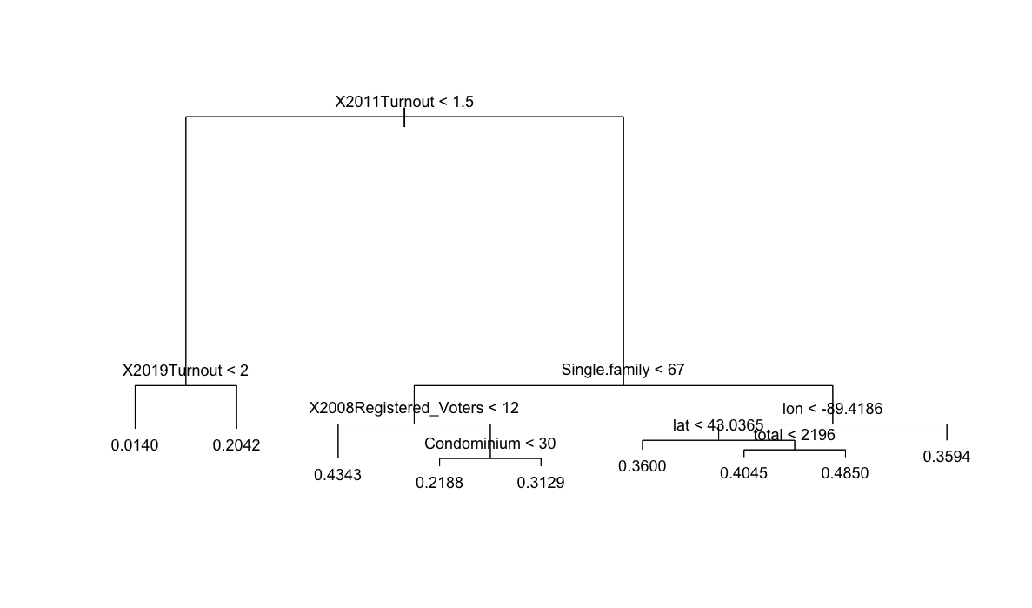

Slide 13
Deterministic Variables
Single Family > 67
Lon and Lat
Total > 2196

Slide 14
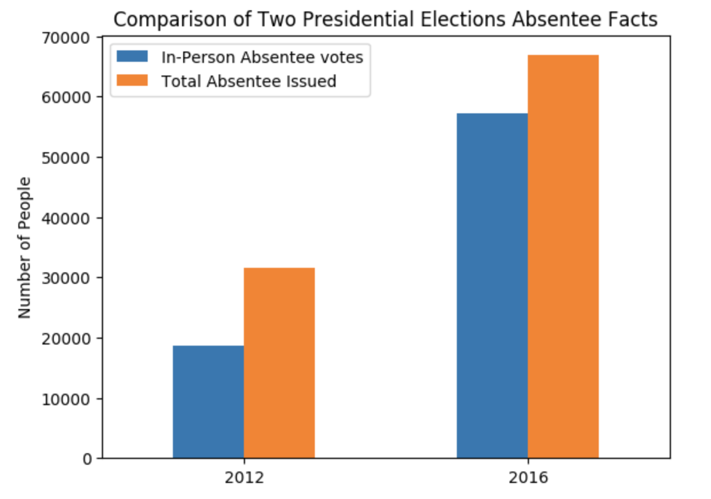
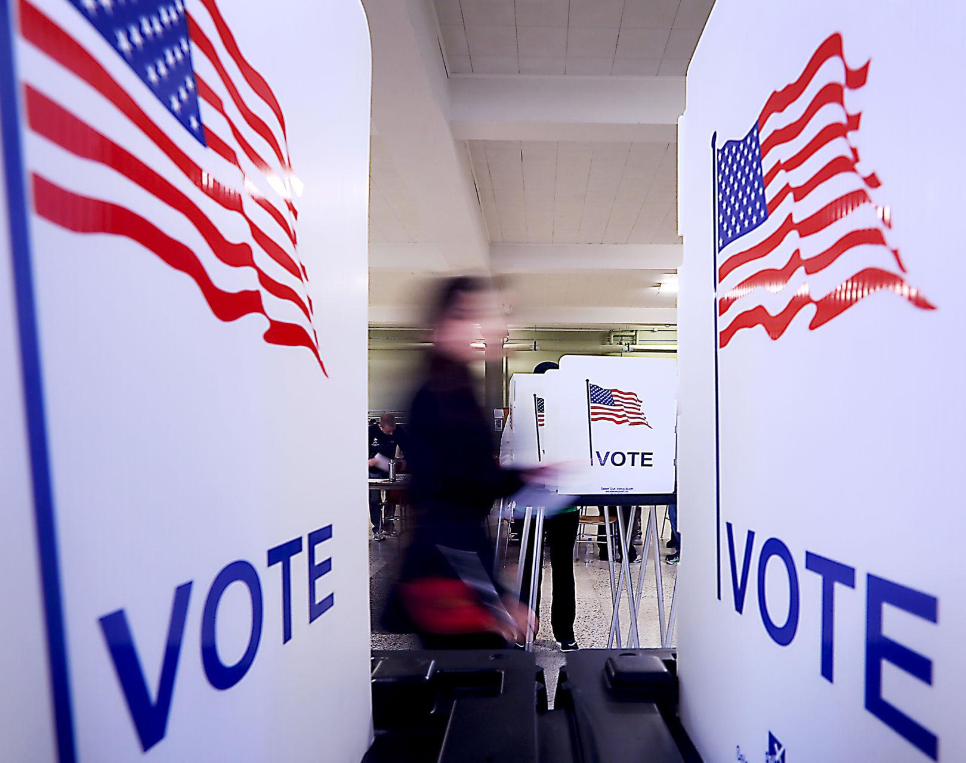
Absentee
2016 presidential election is the first time absentee ballots will be cast at sites other than Downtown. The absentee voting locations expand to twelve new sites.

Slide 15
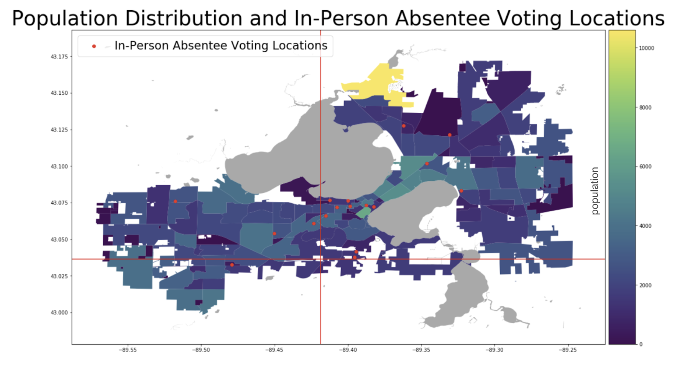

Slide 16
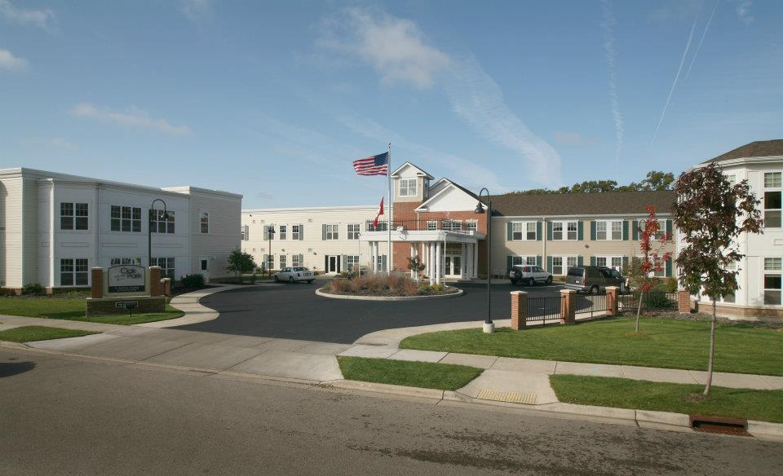
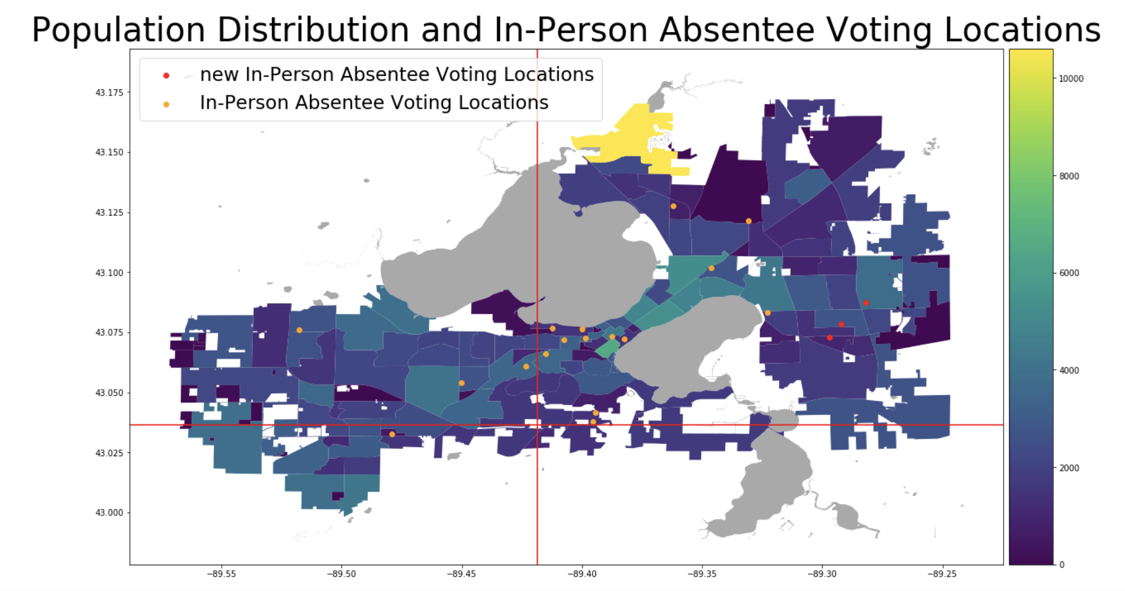

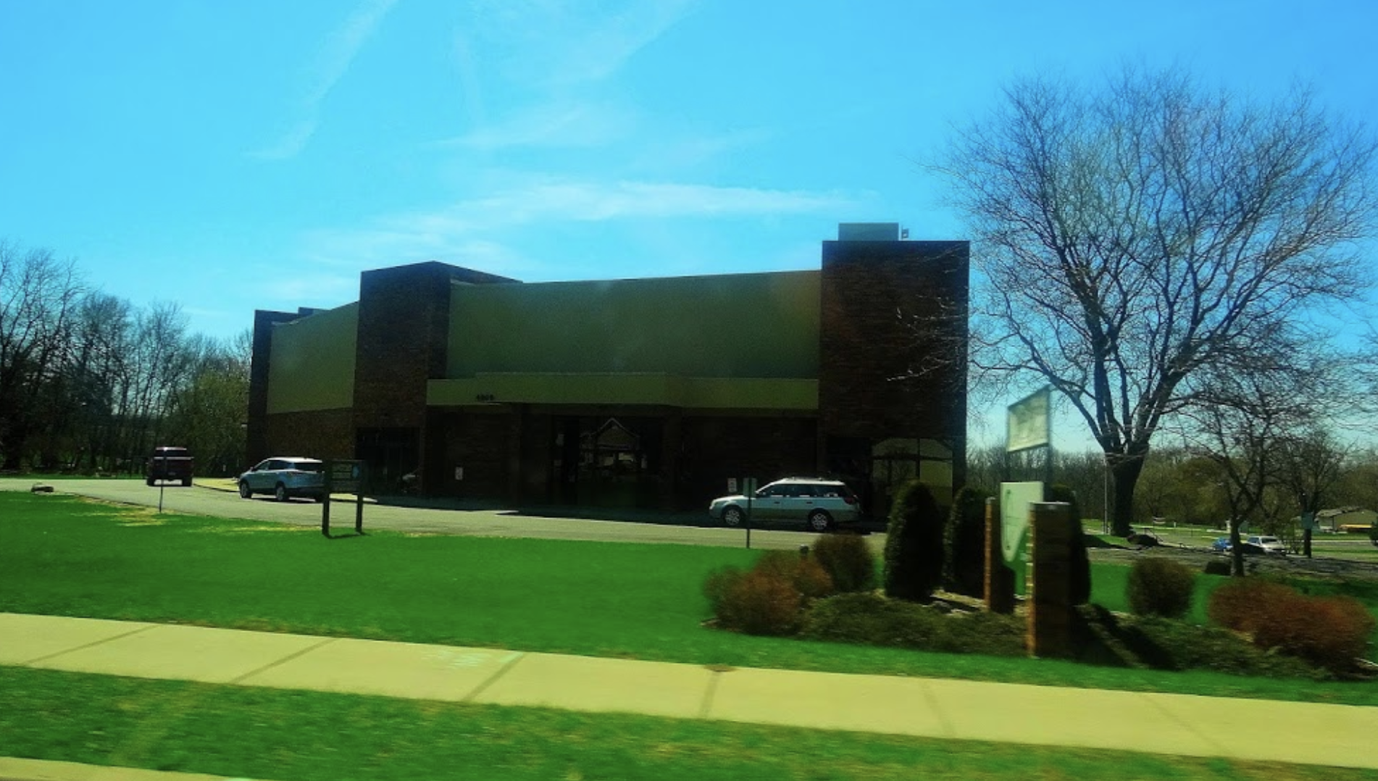
Oak Park Place
Elvehjem Elementary School
City Church

Slide 17
Suggestions
Add Bethel Lutheran Church as a Polling Place
Keep the same strategies of advertisement and education in University
Add Oak Place Park as In-Person Absentee Voting Location

Slide 18
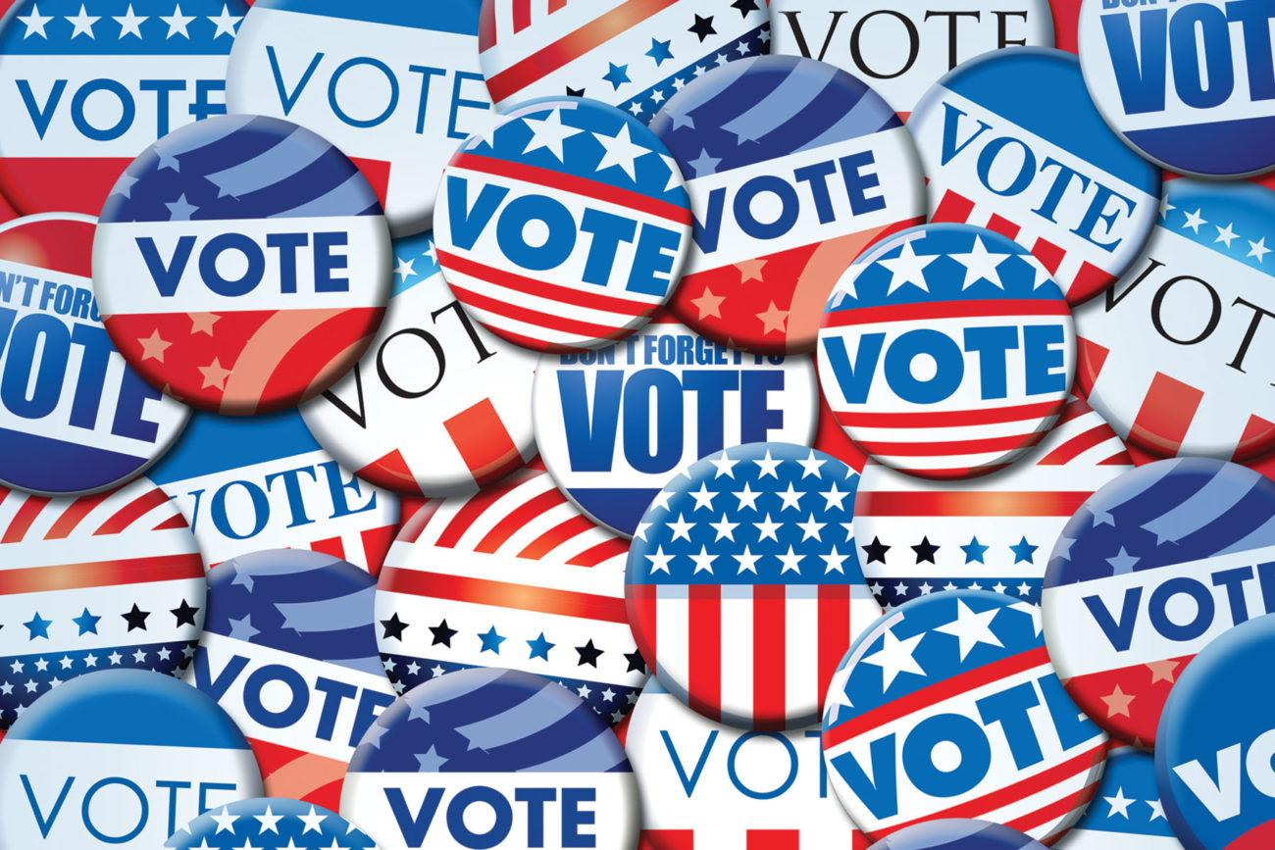
Thank You!

